Slide 1

System Dynamics Model Calibration in Vensim®
A workshop hosted by the CUNY SPH Systems Science Club and the Center for Systems and Community Design
Facilitator: Rachel L. Thompson, MS
April 11, 2024

Slide 2
Agenda
1:00 PM – 1:10 PM Welcome & introductions
1:10 PM – 1:50 PM Lecture on calibration theory
1:50 PM – 2:00 PM Questions & break
2:00 PM – 2:30 PM Vensim setup, model review, & basic calibrations
2:30 PM – 3:00 PM Weighted maximum likelihood estimation
3:00 PM – 3:10 PM Break
3:10 PM – 4:00 PM Markov Chain Monte Carlo simulation & sensitivity analysis
4:00 PM Adjourn

Slide 3
Welcome & Introductions

Slide 4
Workshop Learning Objectives
By the end of this workshop, you should be able to:
Describe the purpose and general process of system dynamics model calibration
List materials needed to calibrate a system dynamics model
Implement naïve and weighted calibrations in Vensim® DSS software
Choose appropriate software options for model calibration in Vensim® DSS
Interpret model calibration outputs from Vensim® DSS software

Slide 5



CUNY SPH Systems Science Club
Rachel L. Thompson, President & Founder
PhD Student, Department of Environmental, Occupational, & Geospatial Health Sciences; Research Associate, Center for Systems & Community Design
The purpose of this student-led club is to provide a space for CUNY SPH students and faculty to come together to learn more about systems modeling methods and discuss their applications to public health research.
Turner Canty, Vice President
MPH (candidate), Department of Health Policy and Management;
Research Assistant, Center for Systems & Community Design
Justine Maffei, Treasurer & Secretary
MPH (candidate), Department of Epidemiology and Biostatistics;
Research Assistant, Center for Systems & Community Design

Slide 6





CUNY SPH Center for Systems & Community Design
https://www.cunycscd.org/
The Center for Systems and Community Design at CUNY SPH develops and tests innovative strategies to tackle complex problems in public health.
Researchers use systems thinking to address different health disparities on the community level.
Nasim Sabounchi, PhD
Associate Professor
Dept of Health Policy and Management, CUNY SPH
Matthew R. Lootens, PhD
Research Assistant Professor
Dept of Health Policy and Management, CUNY SPH
David W. Lounsbury, PhD
Associate Professor
Dept of Epidemiology and Population Health,
Albert Einstein College of Medicine
Terry Huang, PhD, MPH, MBA
Professor and Chair
Dept of Health Policy and Management Director, Center for Systems and Community Design

Slide 7

Ice Breaker
When it’s your turn, please share with the group:
Your name
Your program/department
Your previous experience with systems science
A fun fact about yourself
Then popcorn to someone else!

Slide 8
Calibration Theory

Slide 9


Workshop Materials Attribution
Many of the details and examples for this workshop were taken from the Vensim® Video Library, originally authored by Tom Fiddaman (Ventana Systems, Inc.)
https://vensim.com/vensim-video-library/

Slide 10
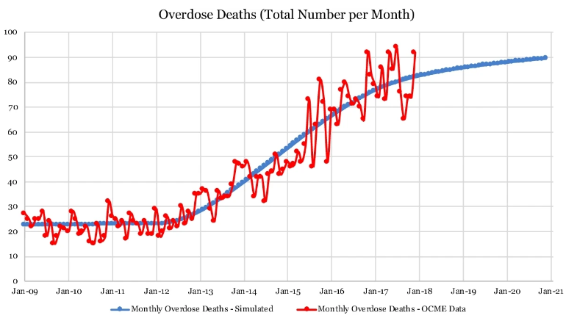
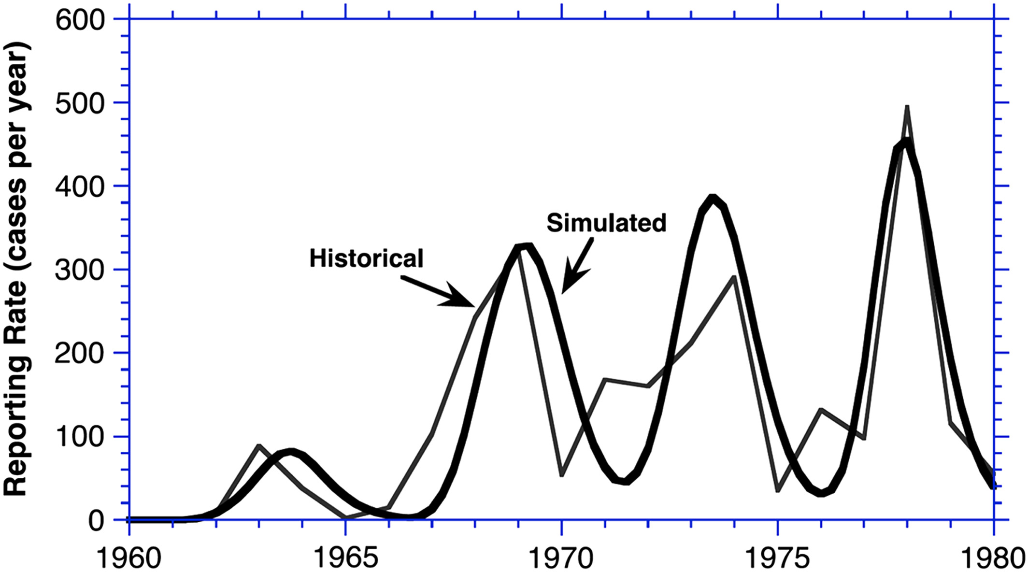
What is model calibration in system dynamics?
“The process of estimating model parameters (structure) to obtain a match between observed and simulated structures and behaviors”
Rogelio Oliva in "Model calibration as a testing strategy for system dynamics models." European Journal of Operational Research 151, no. 3 (2003): 552-568.
Sabounchi, N. S., Heckmann, R., D'Onofrio, G., Walker, J., & Heimer, R. (2022). Assessing the impact of the Good Samaritan Law in the state of Connecticut: a system dynamics approach. Health research policy and systems, 20(1), 5. https://doi.org/10.1186/s12961-021-00807-w
Homer, J. B. (2012). Partial‐model testing as a validation tool for system dynamics (1983). System Dynamics Review, 28(3), 281-294.

Slide 11
Calibration: Purpose
Build more confidence in your model
Reject models that can’t replicate historical data
Make your model more useful
Make better predictions or measurements
Learn more about the model
Investigate areas where model structures could be improved
Learn more about the data
Investigate potential sources of bias and reporting delays

Slide 12
What model calibration IS :
What model calibration IS NOT:
A model validation exercise
A model that fits data well can build trust that you have a reasonable structure
A data vetting exercise
The act of calibration can reveal problems with the data alongside problems with the model
A weak test of model quality
Must be done in conjunction with other model validation exercises (e.g., checking units, verifying dimensional consistency, checking structure with subject matter experts)
The only model validation exercise
A model that fits data well is not necessarily a valid model!!
A source of absolute truth
The data used in calibration carry multiple sources of uncertainty
Errors in data collection
Errors in data reporting
Bias in selection, use, and interpretation of data
Errors in model formulation
Random error

Slide 13
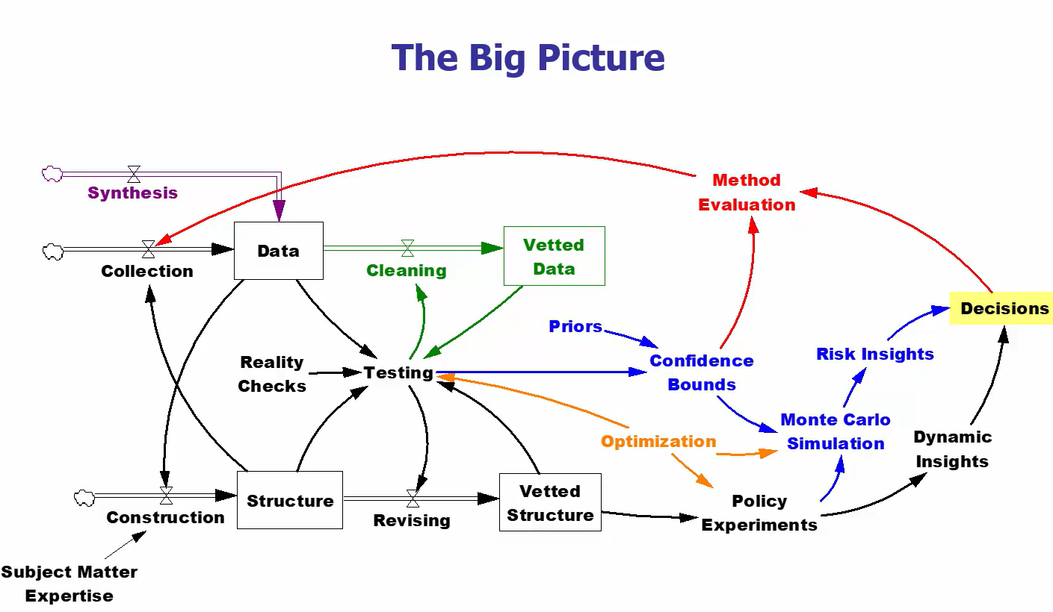

Model calibration is one small part of a larger iterative process of model testing and validation

Slide 14
Calibration: General Process
Assume that model structure is right***
***Test alternatives, if possible!
Simulate the model
Measure closeness between model simulated values and data
Adjust the constant parameters in the model
Iterate to improve fit (minimize difference between model simulated values and data)
This can be done by “hand adjusting” parameters or using an algorithm
After convergence, evaluate fit between data and simulated values
Decide if model needs revision
Investigate potential issues in data

Slide 15
Some Useful Definitions
Calibration: a process that (typically) uses mathematical optimization to find the set of parameter values which minimizes the difference between simulated values and observed data
Optimization: a systematic process aimed at determining the minimum or maximum value of a mathematical function within a given set of constraints
Payoff (Objective Function): a formula which expresses the quantity to be optimized (either minimized or maximized)
Parameter: model values which are (typically) constant over time which influence the behavior of a system – these are the values which are varied during calibration
Estimation: process of determining values of parameters which are not directly measured – this may (or may not) involve using calibration to infer the values based on available data
Maximum likelihood estimation: a statistical method used to estimate the parameters of a probability distribution that best explain observed data

Slide 16
Naïve Calibration

Slide 17
Naïve Calibration
General Process
Create a simple metric (called a payoff or an objective function) measuring the distance between the model simulated values and the data points
Repeatedly vary the values of the parameters by small amounts, measuring the payoff each time
Continue until the difference between the model simulated values and the data points is the smallest you can get (minimize the differences between data and simulation, maximizing the payoff)

Slide 18
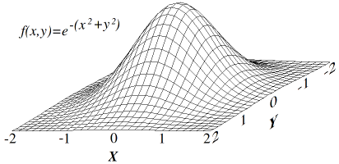
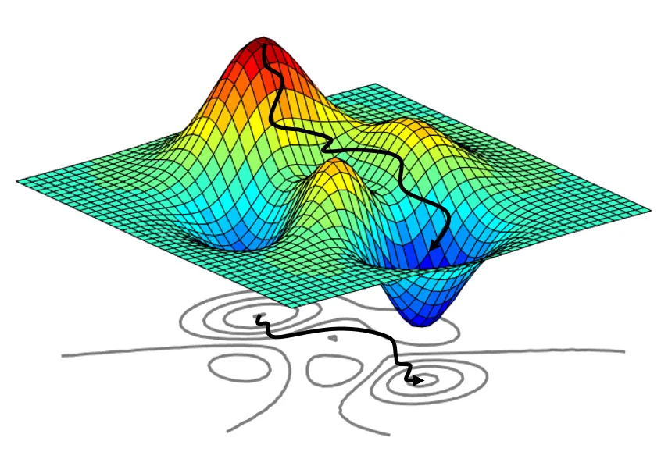
Naïve Calibration
A payoff surface with only one maximum:
What happens when we optimize?
“Hill Climbing” optimizer
Parameters are varied one-by-one and in combinations by small amounts until the best combination of parameter values is found
Algorithm is encouraged to move towards a better and better payoff
This process may need to repeat thousands of times in order to find the maximum payoff (“top of the hill”)
Algorithm stops when it thinks it has reached the maximum payoff
Multiple restarts may be needed in order to find the global maximum (instead of settling in local maxima) since algorithm is blind to complete payoff space
https://en.wikipedia.org/wiki/Hill_climbing#/media/File:Hill_climb.png
A payoff surface with multiple maxima:
https://towardsdatascience.com/an-introduction-to-surrogate-optimization-intuition-illustration-case-study-and-the-code-5d9364aed51b

Slide 19
Naïve Calibration
Pitfalls
Naïve calibration does not properly recognize variations in data scale and data quality
Each data series used to calibrate the model is considered to have equal contribution to the payoff
Equal quality (equal error)
Equal scale
In reality, data used for model calibration varies in scale and quality
Across different measurements (e.g., # of people with a disease vs. # of medications in supply vs. avg. dose of medication)
Over time (bigger data = bigger error, so more absolute error when a disease is highly prevalent vs. extremely rare)
Failing to properly weight the contributions of the data to the payoff means that you won’t be able to accurately characterize uncertainty within the model (e.g., compute confidence bounds)

Slide 20
Maximum Likelihood Estimation & Weighting Payoff Elements

Slide 21
Maximum Likelihood Estimation (MLE)
Goal: choose the values of parameters that maximize the likelihood of observing the data, given the model
Likelihood expresses the probability of getting the data observed from your model, NOT the chance that the model is right
Computation of likelihood (and log likelihood) values incorporates weights for each data series (which can be estimated by calibration, if unknown)

Slide 22
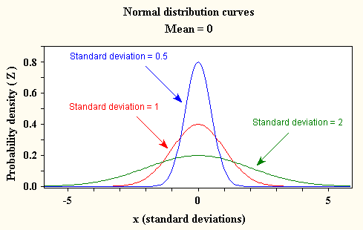
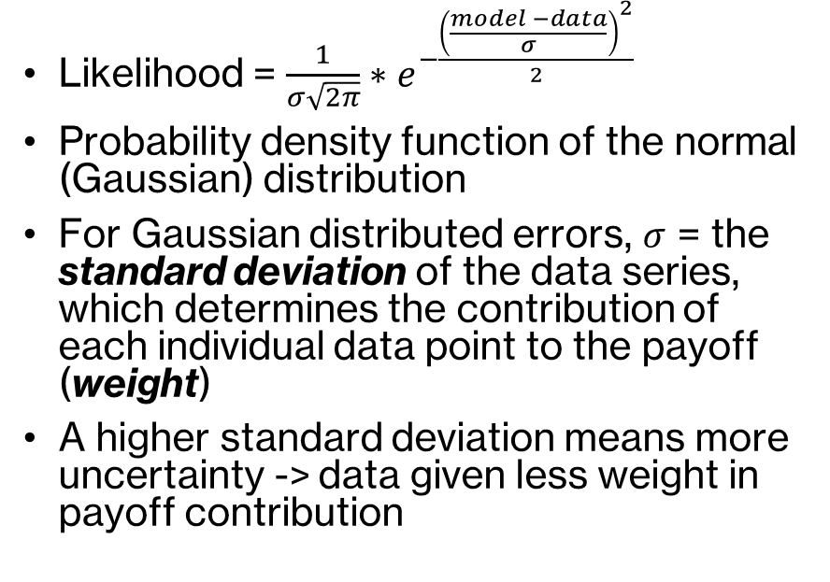
Likelihood Function & Gaussian Errors
Likelihood = $\frac{1}{σ\sqrt{2π}}∗e^{−\frac{{\left(\frac{model −data}{σ}\right)}^{2}}{2}}$
Probability density function of the normal (Gaussian) distribution
For Gaussian distributed errors, $σ$ = the standard deviation of the data series, which determines the contribution of each individual data point to the payoff (weight)
A higher standard deviation means more uncertainty -> data given less weight in payoff contribution
https://influentialpoints.com/Training/normal_distribution-principles-properties-assumptions.htm

Slide 23
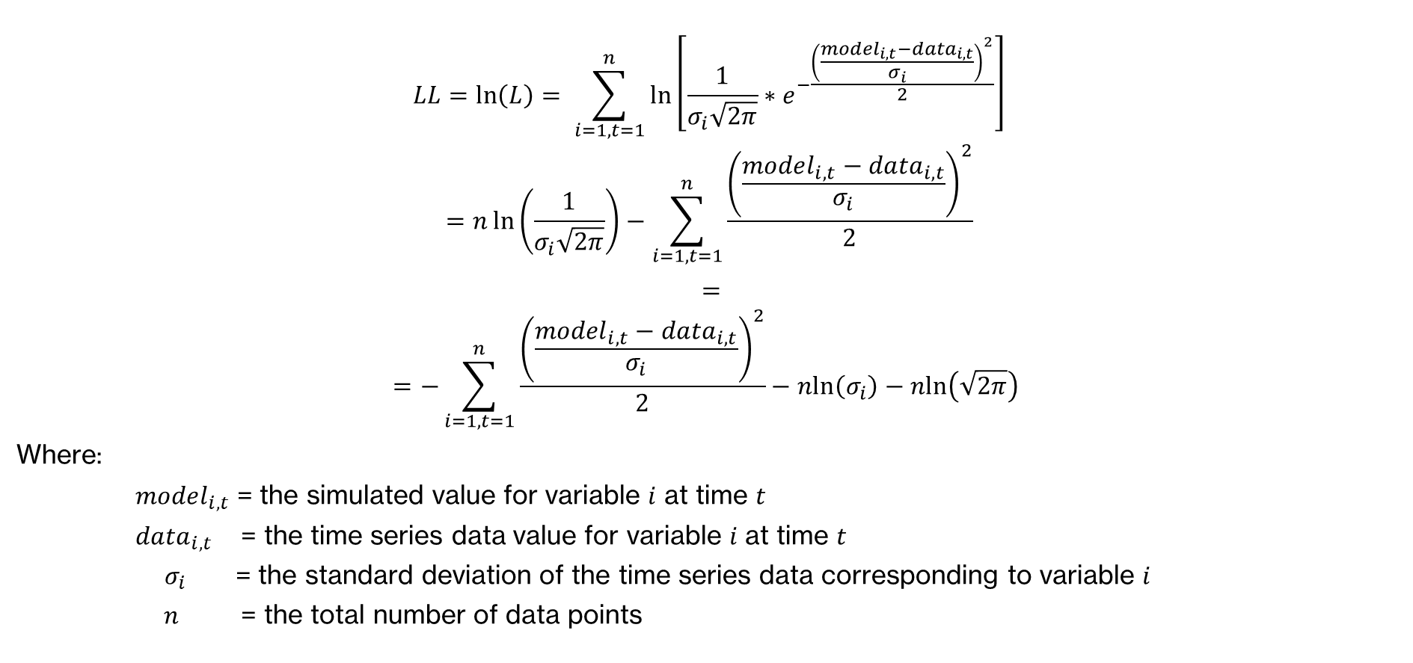
Likelihood Payoff -> Log-Likelihood Payoff
$$LL=\ln\left(L\right)= \sum_{i=1,t=1}^{n}{\ln\left[\frac{1}{σ_{i}\sqrt{2π}}∗e^{−\frac{{\left(\frac{{model}_{i,t}−{data}_{i,t}}{σ_{i}}\right)}^{2}}{2}}\right]}$$
$$=n\ln\left(\frac{1}{σ_{i}\sqrt{2π}}\right)−\sum_{i=1,t=1}^{n}{\frac{{\left(\frac{{model}_{i,t}−{data}_{i,t}}{σ_{i}}\right)}^{2}}{2}}$$
$=$
$$=−\sum_{i=1, t=1}^{n}{\frac{{\left(\frac{{model}_{i,t}−{data}_{i,t}}{σ_{i}}\right)}^{2}}{2}}−nln\left(σ_{i}\right)−\operatorname{nln}\left(\sqrt{2π}\right)$$
Where:
${model}_{i,t}$ = the simulated value for variable $i$ at time $t$
${data}_{i,t}$ = the time series data value for variable $i$ at time $t$
${ σ}_{i}$ = the standard deviation of the time series data corresponding to variable $i$
$n$ = the total number of data points
Notes:
Log transforming the likelihood makes it easier to work with:
Likelihood = $\frac{1}{σ\sqrt{2π}}∗e^{−\frac{{\left(\frac{model −data}{σ}\right)}^{2}}{2}}$
Likelihoods combine multiplicatively
Likelihood for data point A and data point B = likelihood(A) * likelihood(B)
Log likelihoods combine additively
ln(A and B) = ln(likelihood(A)) + ln(likelihood(B))
Maximizing the log likelihood is equivalent to maximizing the likelihood, but more efficient
ln(𝜎) means that the bigger the 𝜎, the smaller the likelihood (distribution spread thinner) – penalty for data with high amount of error/variability
ln(√2𝜋) is a constant
ln(𝑒^(−((𝑚𝑜𝑑𝑒𝑙 −𝑑𝑎𝑡𝑎)/𝜎)^2/2)) weighted sum of squared errors, divided by two **This is the quantity effectively being maximized during optimization
With multiple data points, overall log-likelihood is the sum of each individual log-likelihood for each data point (for likelihood you’d need to multiply)
Log likelihood is a monotonically increasing function
${\left(\frac{model −data}{σ}\right)}^{2}$ = ${\left(\frac{error}{σ}\right)}^{2}$ if we’ve guessed right about $σ$, we would expect this to have a magnitude of ~1
Therefore, for multiple data points expect the total sum to have a magnitude ~ the number of data points used
Indicator of a properly weighted log likelihood payoff with Gaussian distributed errors = number of data points used / 2

Slide 24
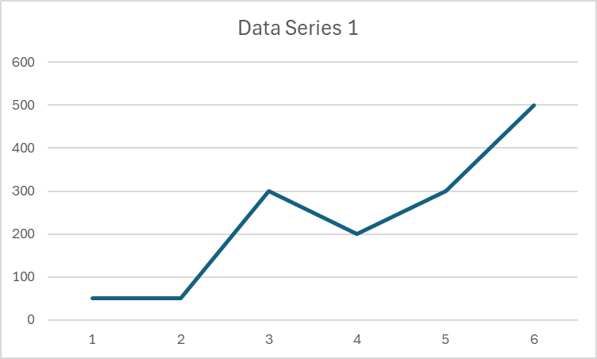
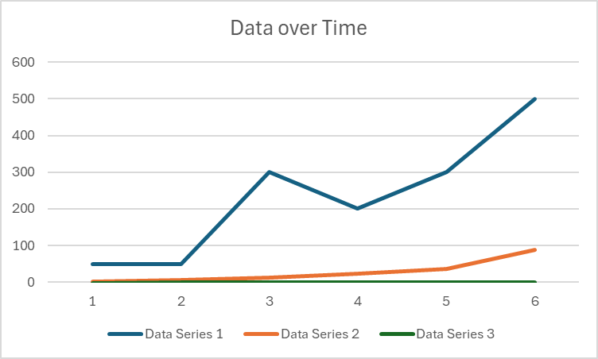
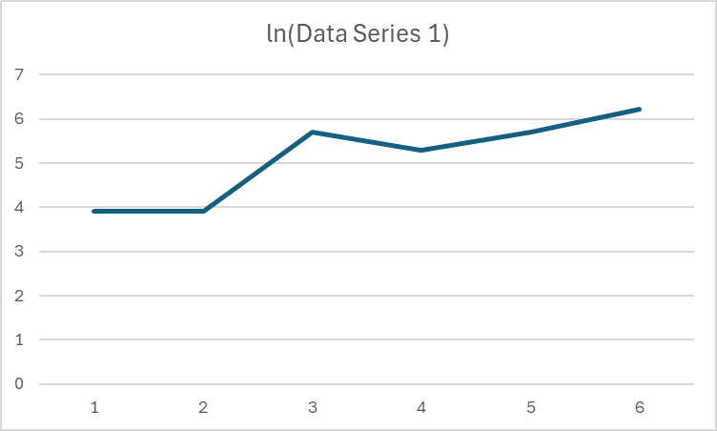
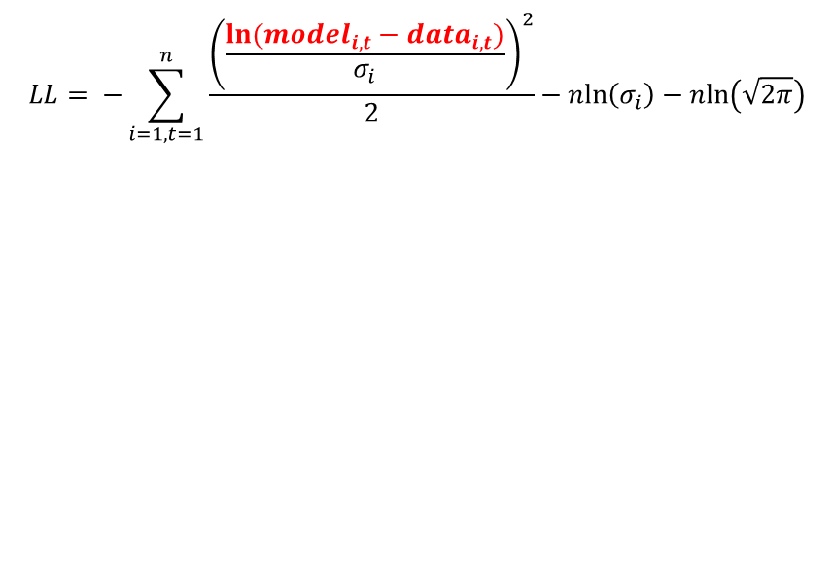
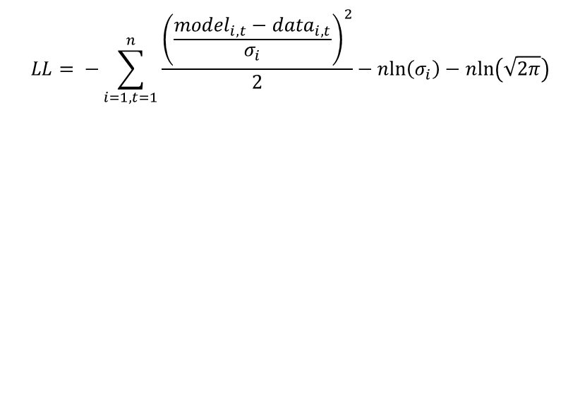

A weighted payoff handles the issue of variability in data scale between data series
Log-transforming errors handles the issue of variability in data scale within a data series
$$LL= −\sum_{i=1, t=1}^{n}{\frac{{\left(\frac{{model}_{i,t}−{data}_{i,t}}{σ_{i}}\right)}^{2}}{2}}−nln\left(σ_{i}\right)−\operatorname{nln}\left(\sqrt{2π}\right)$$
$$LL= −\sum_{i=1, t=1}^{n}{\frac{{\left(\frac{{ln⁡(model}_{i,t}−{data}_{i,t})}{σ_{i}}\right)}^{2}}{2}}−nln\left(σ_{i}\right)−\operatorname{nln}\left(\sqrt{2π}\right)$$

Slide 25
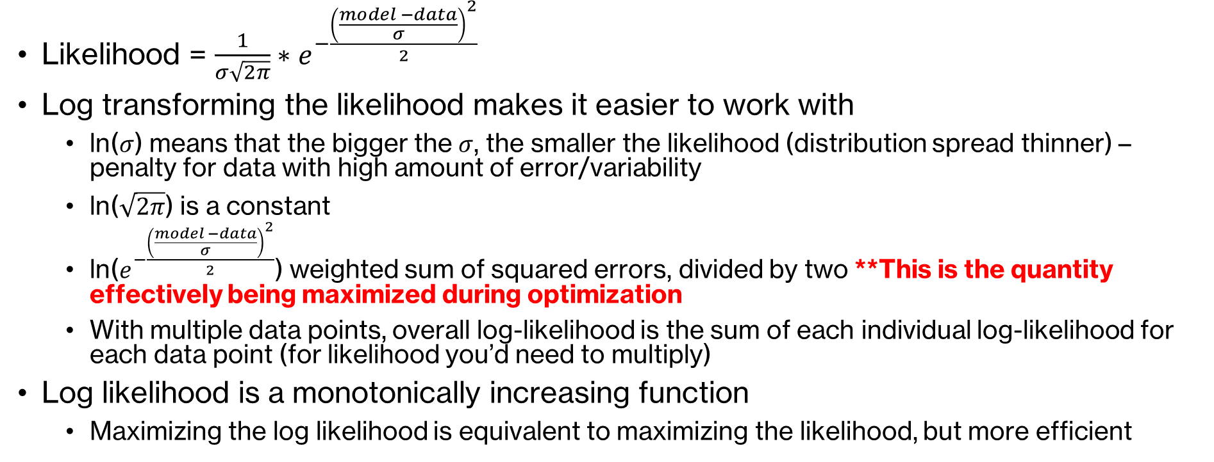
Calculating Log-Likelihood Payoff with Gaussian Errors
Likelihood = $\frac{1}{σ\sqrt{2π}}∗e^{−\frac{{\left(\frac{model −data}{σ}\right)}^{2}}{2}}$
Log transforming the likelihood makes it easier to work with
ln($σ$) means that the bigger the $σ$, the smaller the likelihood (distribution spread thinner) – penalty for data with high amount of error/variability
ln($\sqrt{2π}$) is a constant
ln($e^{−\frac{{\left(\frac{model −data}{σ}\right)}^{2}}{2}}$) weighted sum of squared errors, divided by two **This is the quantity effectively being maximized during optimization
With multiple data points, overall log-likelihood is the sum of each individual log-likelihood for each data point (for likelihood you’d need to multiply)
Log likelihood is a monotonically increasing function
Maximizing the log likelihood is equivalent to maximizing the likelihood, but more efficient

Slide 26
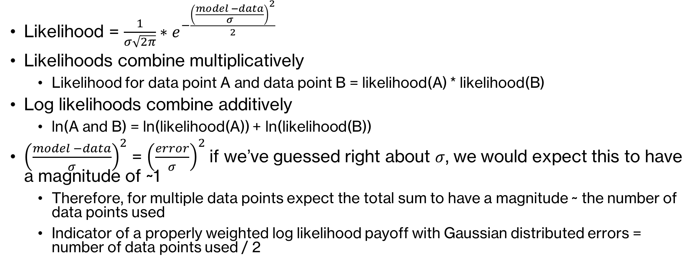
Calculating Log-Likelihood Payoff with Gaussian Errors
Likelihood = $\frac{1}{σ\sqrt{2π}}∗e^{−\frac{{\left(\frac{model −data}{σ}\right)}^{2}}{2}}$
Likelihoods combine multiplicatively
Likelihood for data point A and data point B = likelihood(A) * likelihood(B)
Log likelihoods combine additively
ln(A and B) = ln(likelihood(A)) + ln(likelihood(B))
${\left(\frac{model −data}{σ}\right)}^{2}$ = ${\left(\frac{error}{σ}\right)}^{2}$ if we’ve guessed right about $σ$, we would expect this to have a magnitude of ~1
Therefore, for multiple data points expect the total sum to have a magnitude ~ the number of data points used
Indicator of a properly weighted log likelihood payoff with Gaussian distributed errors = number of data points used / 2

Slide 27

Methods for Determining $σ$
Educated guess or prior knowledge
“plus or minus x%”
Iterate
Run the model
Look at payoff or residuals
Manually adjust error to improve fit
Estimate as part of calibration
Include the error or weight as an optimized parameter
Add extra weight terms to the payoff

Slide 28
Payoff Element Options in Vensim ®
Normal
Gaussian***
Default option
Simplest, used for initial (naïve) calibrations
Computes Likelihood payoff
Can’t estimate weights using calibration
Most commonly used, often best choice
Computes Log likelihood payoff
Possible to estimate the error scale as an optimization parameter

Slide 29
Payoff Element Options in Vensim ®
Robust
Others
Underlying assumption that errors have Laplace or double exponential distribution
Laplace likelihood
Resistant to impacts on calibration from highly skewed data/extreme outliers
Kalman
Huber
Binomial
Poisson
https://www.vensim.com/documentation/extended_payoffs.html
How do I know which error distribution to use? -> Verify post-calibration by checking distributions of model residuals (differences between simulated values and data)

Slide 30
Payoff Element Options in Vensim ®
Logarithmic Transformation
Take logarithms of model and data values before computing payoff contributions
Provides lognormal errors, rather than standard normal assumption

Slide 31
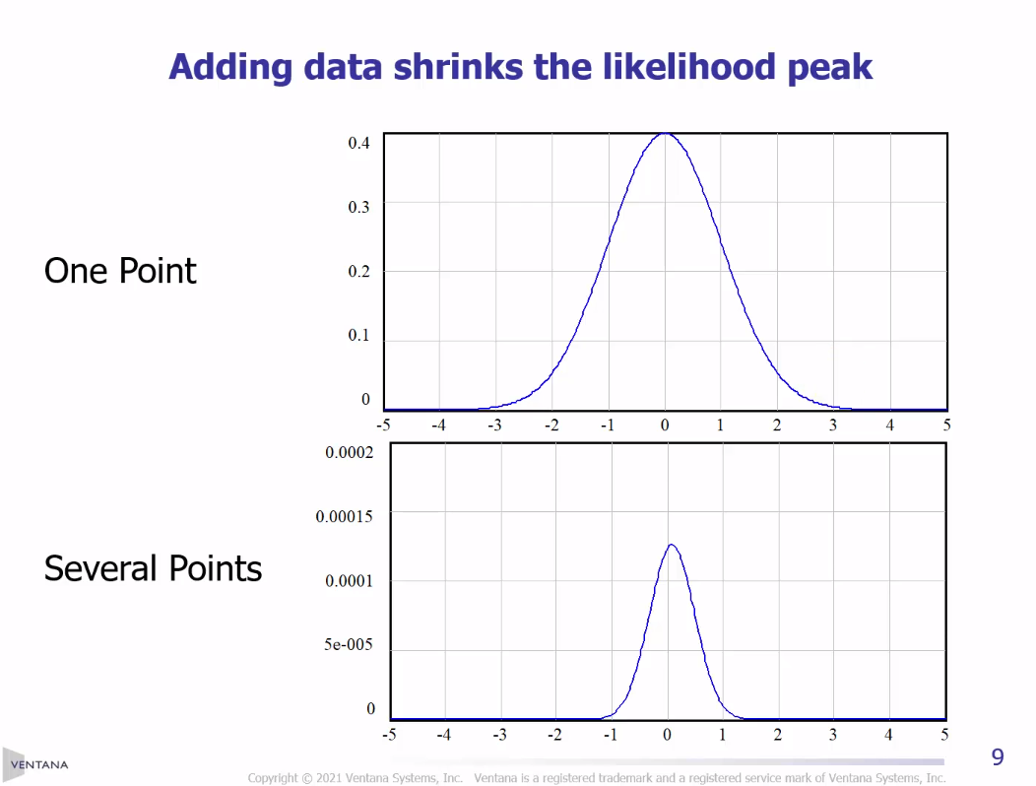
In MLE, More Data is Better… Better Data is Also Better
Combining noisy measurements from multiple sources shrinks the likelihood peak
Better data also shrinks the likelihood peak
Narrower likelihood peak = better idea of what “true” value may be

Slide 32
Summary: Model Calibration Steps
Build an SD model
Identify relevant time series data
Define a payoff by identifying the relevant:
Data series and matching model variables
Error distribution (e.g., Gaussian)
Likelihood function (e.g., Likelihood or Log Likelihood)
Error/weight values (could be estimated or guesstimated)
Iteratively vary parameter values one-by-one and together to obtain the set of values which maximizes the payoff (i.e., likelihood of observing the data, given the model)
Evaluate model fit to data
Make any changes to model structure, investigate issues with data, and examine model residuals
Repeat starting with step 3, making any necessary changes to the payoff definition

Slide 33
Questions & Break

Slide 34
Vensim Setup & Model Review

Slide 35
Vensim® Setup
Everyone should be running Vensim® DSS
Let me know if you don’t have a copy and I can help you install a temporary workshop version
Download workshop materials from my Github page: https://github.com/ralythompson24/sd-model-calibration-in-vensim-workshop

Slide 36
Model Review
Open SEIR Model.mdl in Vensim®
Explore the model structures and equations
Run the model – what do you observe?

Slide 37
Basic (Naïve) Calibrations

Slide 38
Calibration in Vensim ®
What do we need?
Data (.vdf file or equations with GET DIRECT DATA, GET XLS DATA)
Payoff Definition (.vpd file)
Specify which data series to match to which variables in the model, how to weight each data series (by specifying the error distribution)
Optimization Control File (.voc file)
Specify which parameters to vary and ranges
Specify which optimization methods to use

Slide 39
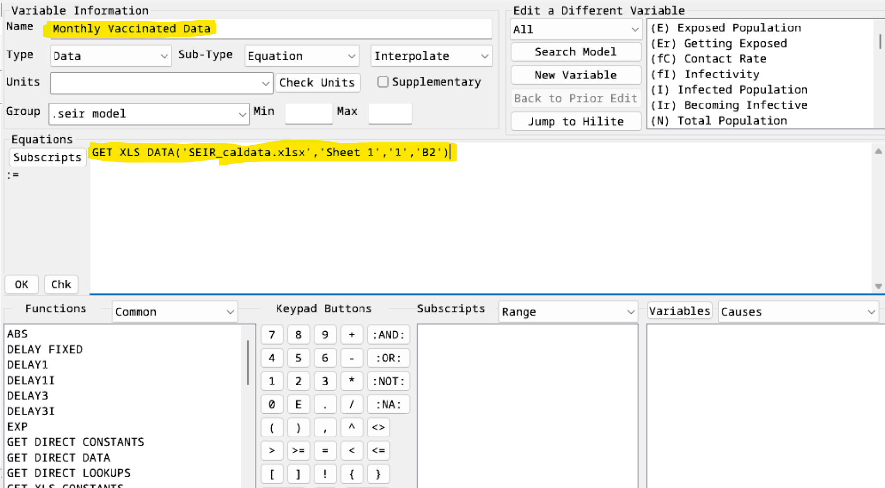
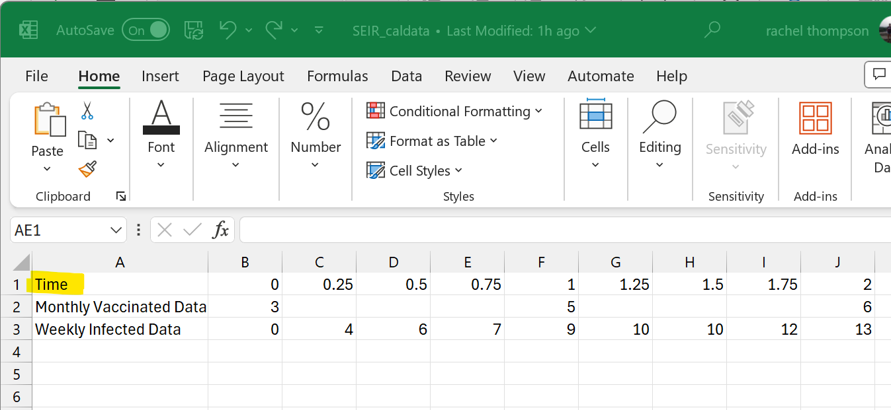
Calibration in Vensim ®
What do we need?
Data (.vdf file or equations with GET DIRECT DATA, GET XLS DATA)
This model has come pre-loaded with data using a GET XLS DATA function

Slide 40
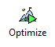
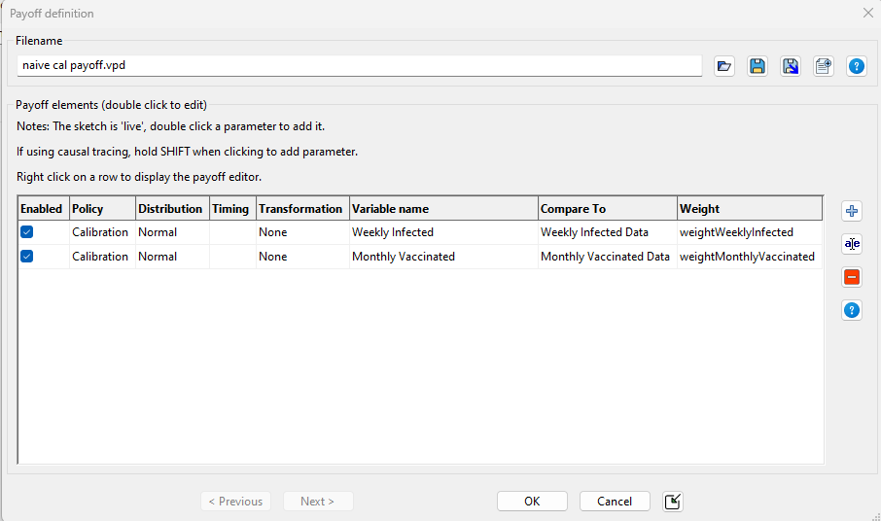
Calibration in Vensim ®
What do we need?
Payoff Definition (.vpd file)
Specify which data series to match to which variables in the model, how to weight each data series (by specifying the error distribution)
In “Simulation Control” under “Optimize”
set up file `naive cal payoff.vpd` with the following settings:

Slide 41
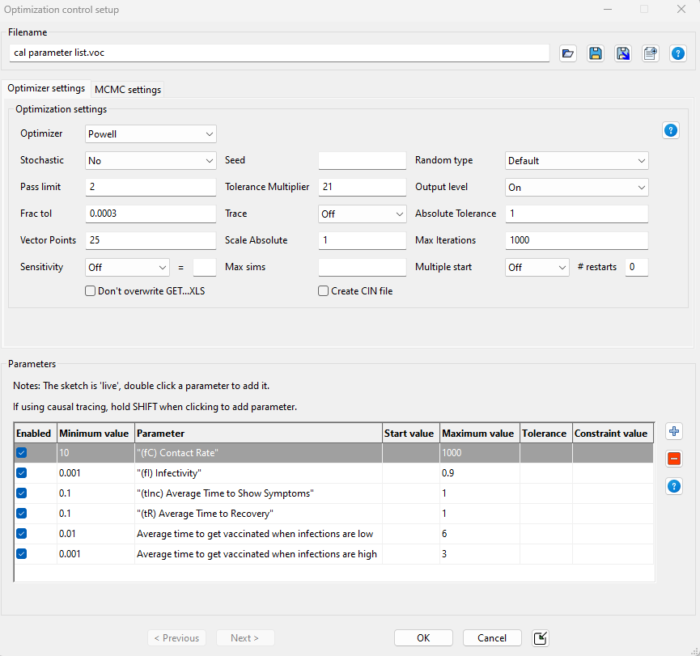
Calibration in Vensim ®
What do we need?
Optimization Control File (.voc file)
Specify which parameters to vary and ranges
Specify which optimization methods to use
In “Simulation Control” under “Optimize”
set up file `cal parameter list.voc` with the following settings:

Slide 42
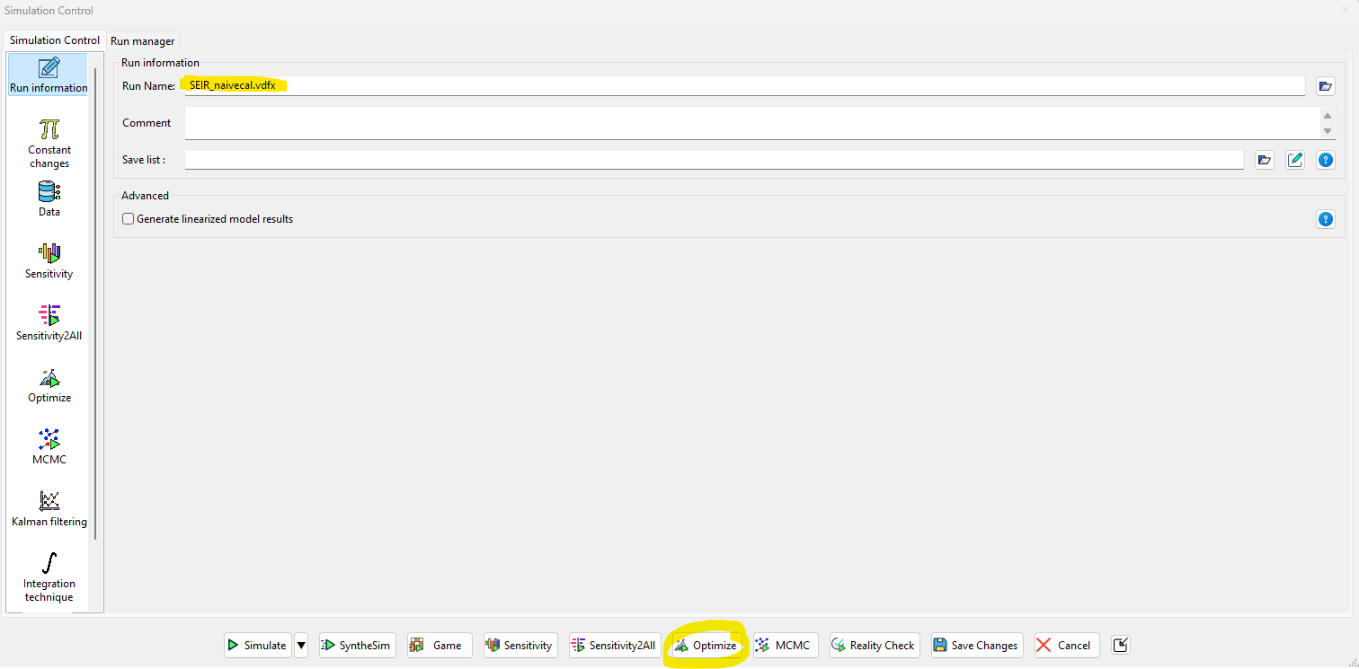
Calibration in Vensim ®
Let’s Calibrate!
Save the run name as “SEIR_naivecal.vdfx”
Hit “Optimize”

Slide 43
Calibration in Vensim ®
What do we get?
A Vensim® run with simulation results after setting the parameters to the best values obtained from the calibration (.vdfx file)
An output file summarizing the best parameter values from the calibration (.out file)
This file type can be loaded to set the values within the model to these new calibrated values, or be used as a starting point for another calibration or sensitivity analysis
A payoff report with diagnostic statistics on the calibration (.rep file)

Slide 44
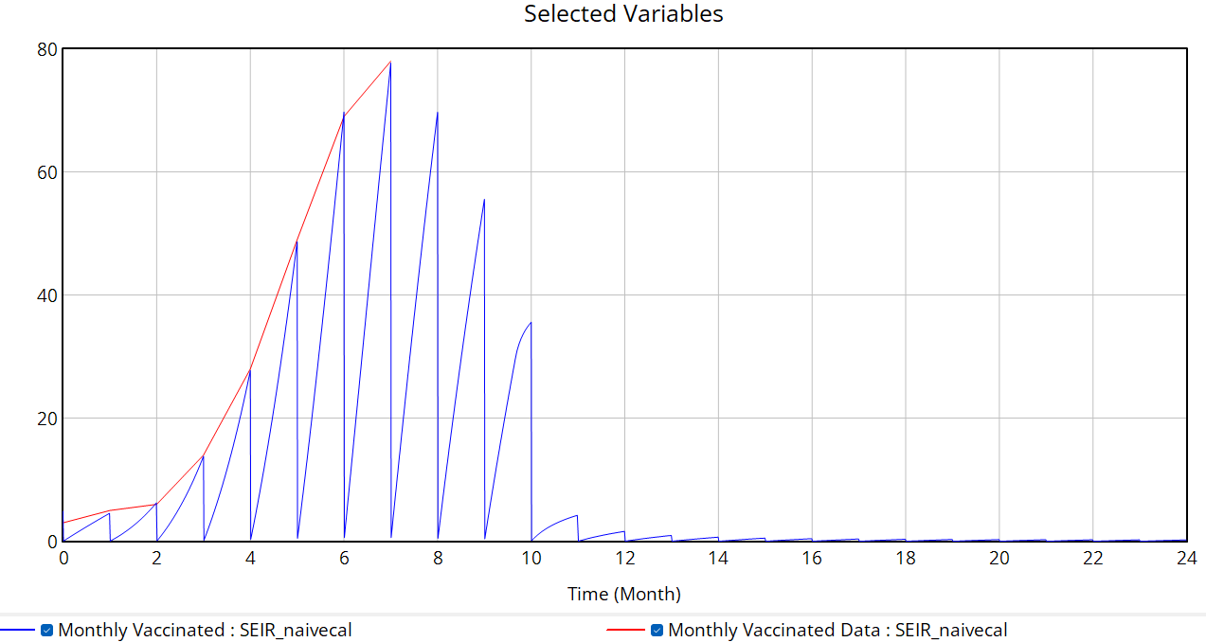
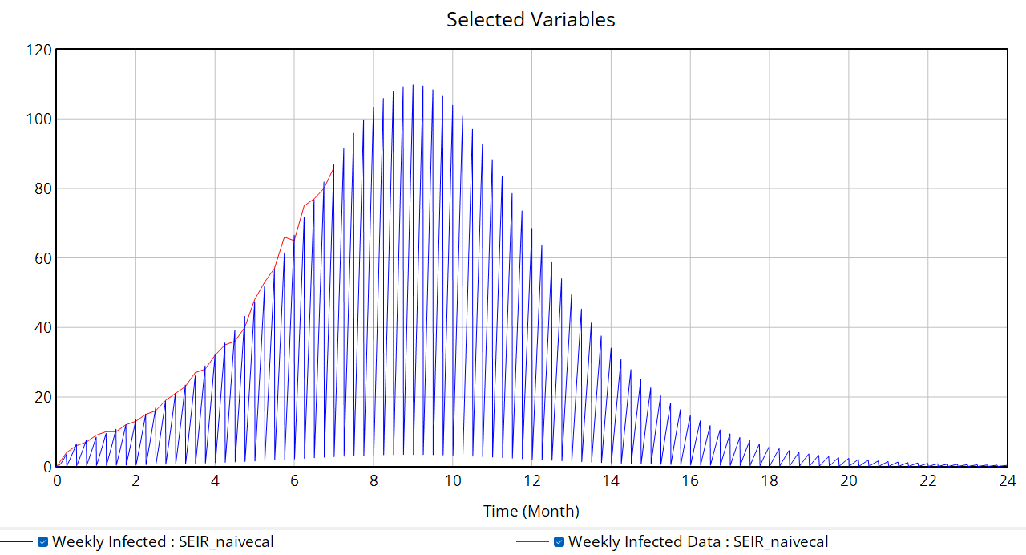
Calibration in Vensim ®
What do we get?
A Vensim® run with simulation results after setting the parameters to the best values obtained from the calibration (.vdfx file)
SEIR_naivecal.vdfx

Slide 45
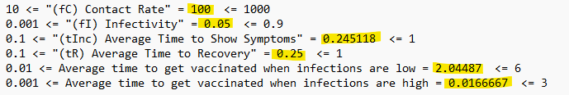
Calibration in Vensim ®
What do we get?
An output file summarizing the best parameter values from the calibration (.out file)
This file type can be loaded to set the values within the model to these new calibrated values, or be used as a starting point for another calibration or sensitivity analysis
SEIR_naivecal.out

Slide 46
Calibration in Vensim ®
What do we get?
A payoff report with diagnostic statistics on the calibration (.rep file)
SEIR_naivecal.rep
Um: difference in mean between model and data (systematic difference/bias)
Us: unequal variance (indicates difference in dynamics)
Uc: unequal covariance (most variance should be here)
For more details see Sterman (1984) “Appropriate summary statistics for evaluating the historical fit of system dynamics models” https://systemdynamics.org/wp-content/uploads/assets/dynamica/volume-10/10-2/4.pdf

Slide 47
Weighted Calibration using Maximum Likelihood Estimation

Slide 48
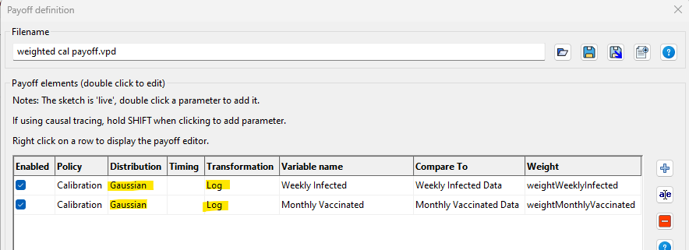
Update the payoff definition file
In “Simulation Control” under “Optimize”
set up file `weighted cal payoff.vpd` with the following settings:

Slide 49
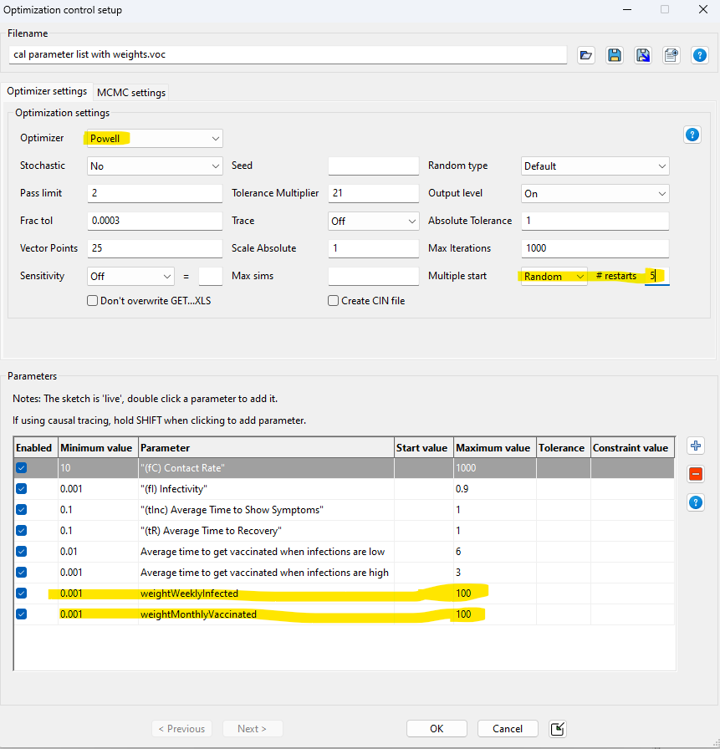
Update the optimization control file
In “Simulation Control” under “Optimize”
set up file `cal parameter list.voc` with the following settings:

Slide 50
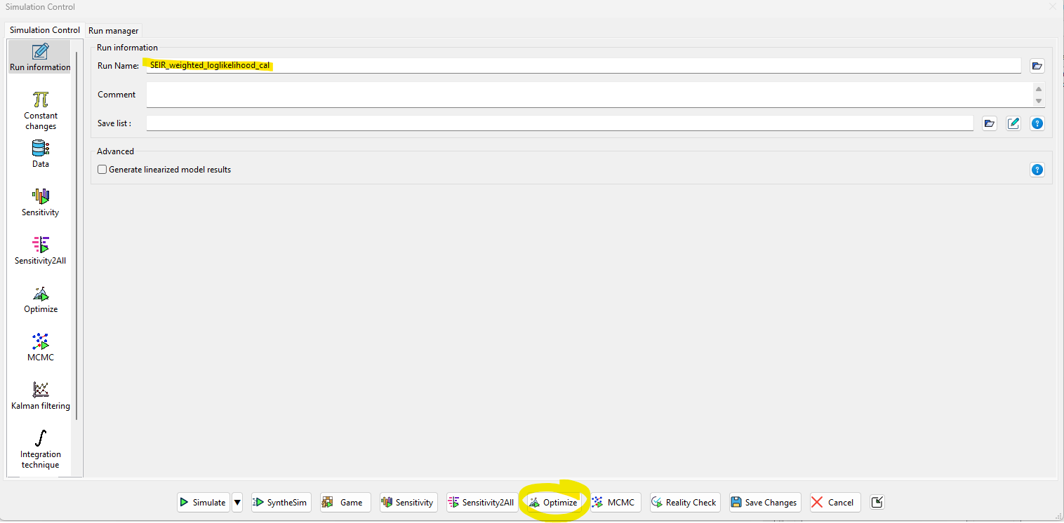
Calibration in Vensim ®
Let’s Calibrate!
Save the run name as “SEIR_weighted_loglikelihood_cal.vdfx”
Hit “Optimize”

Slide 51
Weighted log-likelihood calibration results
Explore the following files
SEIR_weighted_loglikelihood_cal.vdfx (Vensim® run)
SEIR_weighted_loglikelihood_cal.out (best parameter values found)
SEIR_weighted_loglikelihood_cal.rep (payoff diagnostics report)

Slide 52
Optional: calibrate a model with a structure mismatch
Using the same process as we took earlier, calibrate either of the following models towards the relevant data series
SIR model.mdl (simple SIR model, calibrate only towards weekly infections data)
SIR model with vaccinations.mdl (SIR model with vaccination structure, calibrate towards both weekly infections and monthly vaccinations data)
Were you able to obtain a good model fit with either calibration? Why or why not?
Is there any other information which you could think might help improve the model fit?

Slide 53
Break

Slide 54
Quantifying Uncertainty Using Markov Chain Monte Carlo Simulation

Slide 55
Quantifying Uncertainty: Generating Confidence Bounds
Why do we care about quantifying uncertainty of SD model parameters?
Evaluate predictive capacity of the model
Stakeholder decisions may rely on their degree of confidence in the model
Test to see if impacts of policies are (statistically) significantly different from zero
Does uncertainty matter for policy (do policy impacts differ under uncertain values of parameters?)
What additional data or information might narrow the confidence bounds (decrease uncertainty?)

Slide 56
Quantifying Uncertainty: Generating Confidence Bounds
Old Way
New Ways
Optimize to find the best fit of model to data
Explore the payoff space around the maximum payoff
Bootstrapping (draw random samples, with replacement, from the data)
See how estimates vary with different samples from data
Markov Chain Monte Carlo (MCMC)
Explore entire parameter space using random walk to see what parameter values are used most frequently
We will be focusing on applying MCMC to derive confidence bounds in this workshop

Slide 57
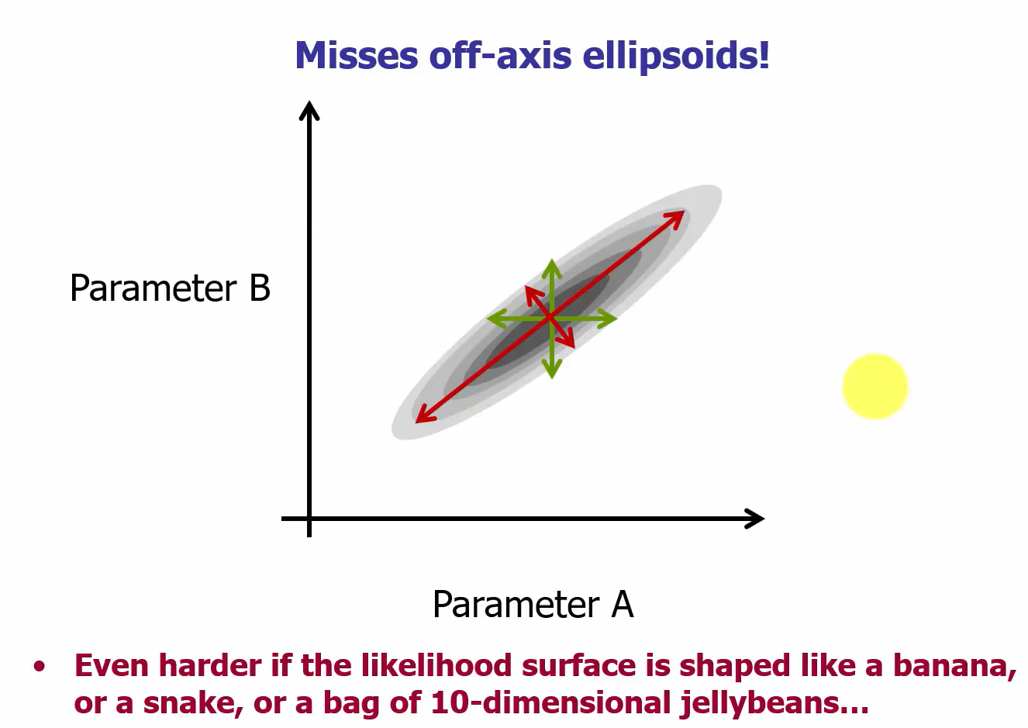
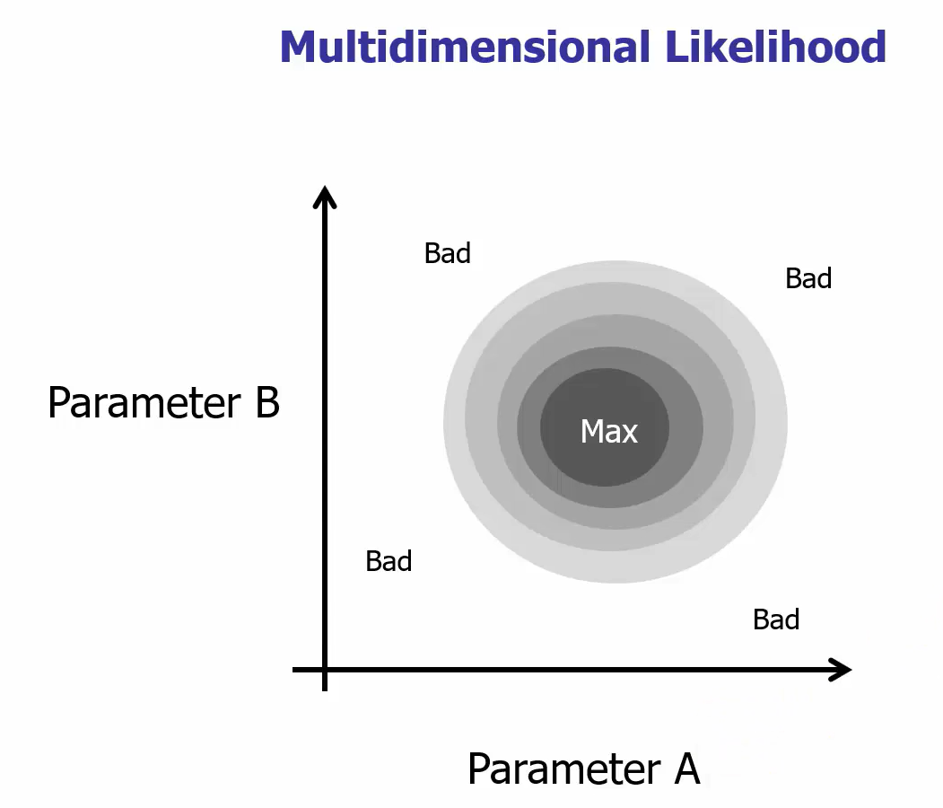
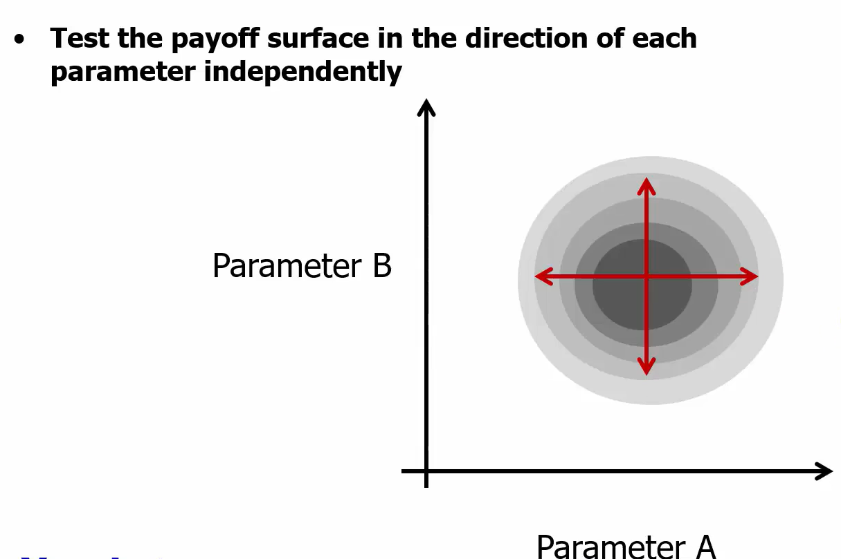

Quantifying Uncertainty: Generating Confidence Bounds
Old Way

Slide 58
Some Useful Definitions
Markov Chain: a “memoryless stochastic process” of movement, where the probability of transitioning from one state to the next is dependent only on the current state
Monte Carlo: a method for drawing random samples from complex probability distributions
Markov Chain Monte Carlo: a “random walk” process, combining Markov chain and Monte Carlo estimation used to generate a representative distribution of samples from some complex probability distribution

Slide 59
MCMC Steps
Initialization: start with an initial state in the state space
Proposal step: propose a new state to move to, based on some probabilistic rule depending on the current state
Acceptance step: decide whether to accept the proposed state or stay in the current state (compare probability of proposed state under target distribution with probability of current state)
Repeat: repeat proposal and acceptance steps many times, generating sequence of states – as the number of iterations increases, the distribution of states converges to the target distribution
https://bookdown.org/kevin_davisross/bayesian-reasoning-and-methods/mcmc.html

Slide 60
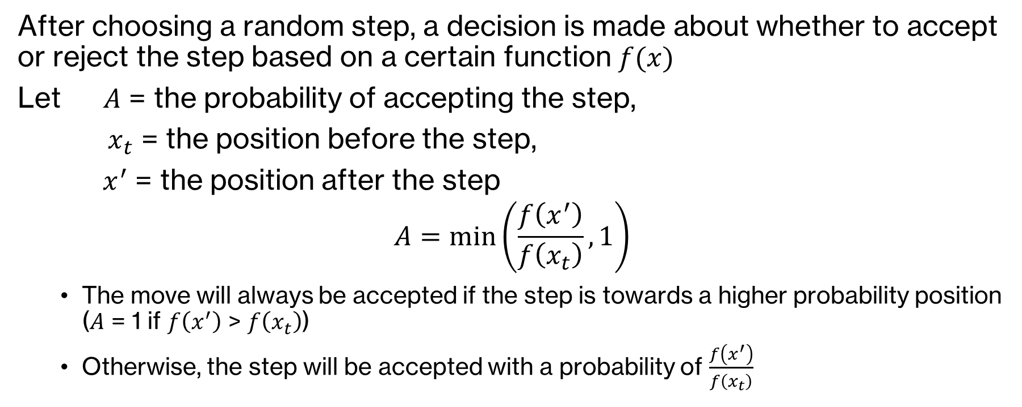
Metropolis Acceptance Criterion
After choosing a random step, a decision is made about whether to accept or reject the step based on a certain function $f(x)$
Let $A$ = the probability of accepting the step,
$x_{t}$ = the position before the step,
$x^{′}$ = the position after the step
$$A=\min\left(\frac{f\left(x^{′}\right)}{f\left(x_{t}\right)}, 1\right)$$
The move will always be accepted if the step is towards a higher probability position ($A$ = 1 if $f\left(x^{′}\right)$ > $f\left(x_{t}\right)$)
Otherwise, the step will be accepted with a probability of $\frac{f\left(x^{′}\right)}{f\left(x_{t}\right)}$
https://www.algorithm-archive.org/contents/metropolis/metropolis.html

Slide 61
MCMC Procedure in Vensim®
Perform a “random walk” over the payoff surface, with steps chosen according likelihood of payoff at proposed point (Metropolis acceptance criteria)
Stationary distribution of the Markov process reflects likelihood surface
After running for a long time, the random walk tends to concentrate in the areas of higher likelihood
Vensim® uses a differential evolution algorithm to guide walk (multiple Markov chains are run and recombined from population to propose next move)

Slide 62
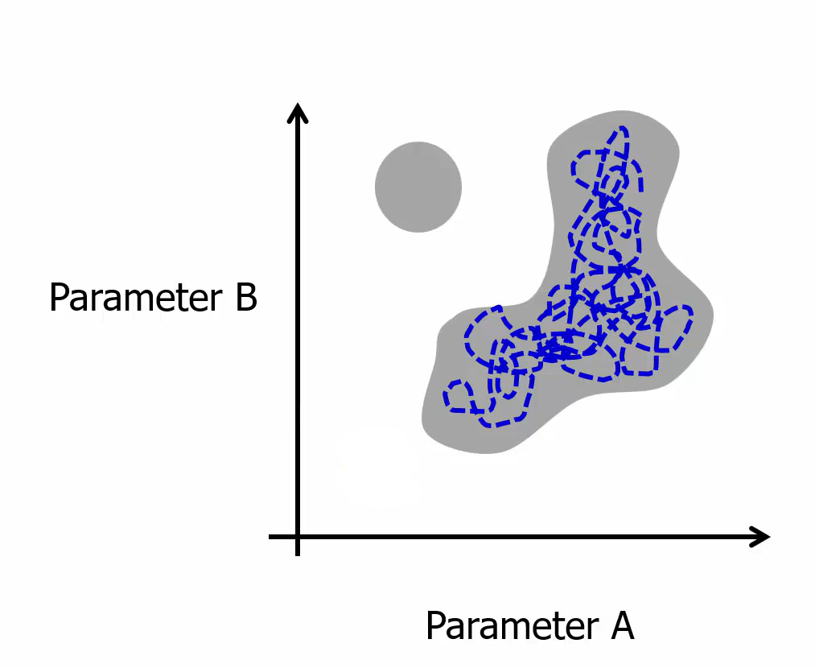
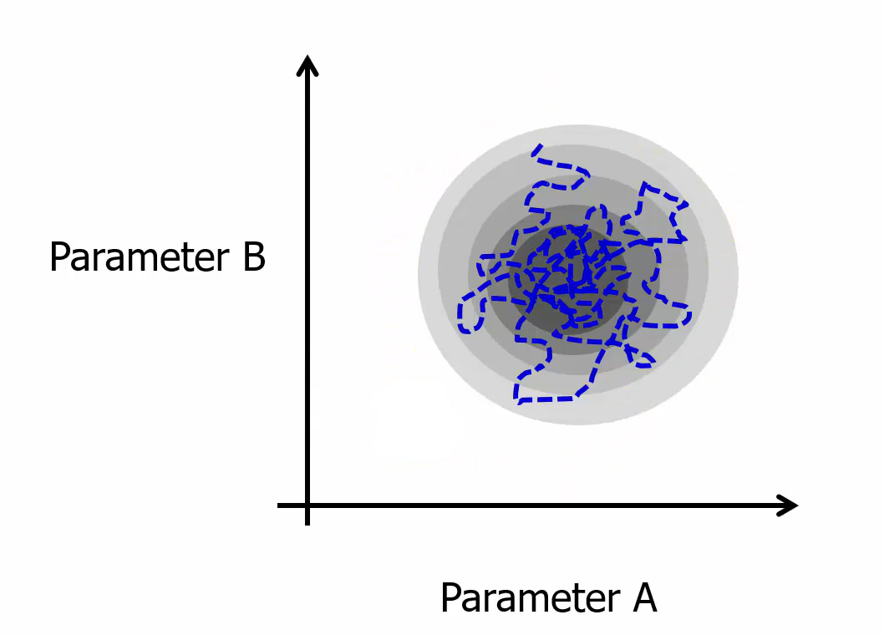
MCMC Procedure

Slide 63
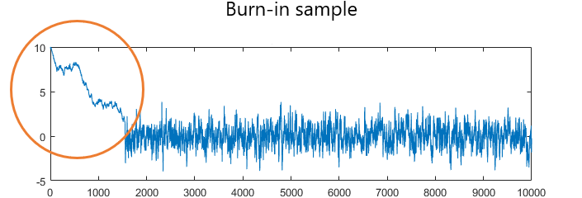
MCMC Procedure
Burn-In Period
Set of iterations of the random walk which are discarded
Eliminate draws whose distributions are far from the target distribution and highly variable
Sampling Period
Iterations of the random walk after the burn-in period ends
These are the runs we keep
Each run is a slightly different variation of the calibrated parameter values
Taboga, Marco (2021). "Markov Chain Monte Carlo (MCMC) methods", Lectures on probability theory and mathematical statistics. Kindle Direct Publishing. Online appendix. https://www.statlect.com/fundamentals-of-statistics/Markov-Chain-Monte-Carlo.

Slide 64
MCMC Convergence Statistics
Gelman-Rubin PSRF “Potential Scale Reduction Factor”
Measures the convergence of the random walk process
Does random walk fully occupy parameter space?
PSRF helps us know whether the simultaneous Markov chains have settled down and are giving consistent (similar) results
If PSRF is close to 1, the chains are all giving similar results
As a rule of thumb, PSRF below 1.2 for all parameters indicates convergence of chains

Slide 65
MCMC in Vensim®
Payoff
Control File
We want the input to be (reasonably close to) a log-likelihood
We can use the same weighted payoff we already developed
Use the same parameter set
Change optimizer to MCMC
Possibly set other options

Slide 66
Load previous calibration
In “Simulation Control” under “Optimize”
set up file `weighted cal payoff.vpd` with the following settings (note that these are the
same settings we used for the weighted log-likelihood Powell calibration

Slide 67
Update the payoff definition file
In “Simulation Control” under “Optimize”
set up file `weighted cal payoff.vpd` with the following settings (note that these are the
same settings we used for the weighted log-likelihood Powell calibration

Slide 68
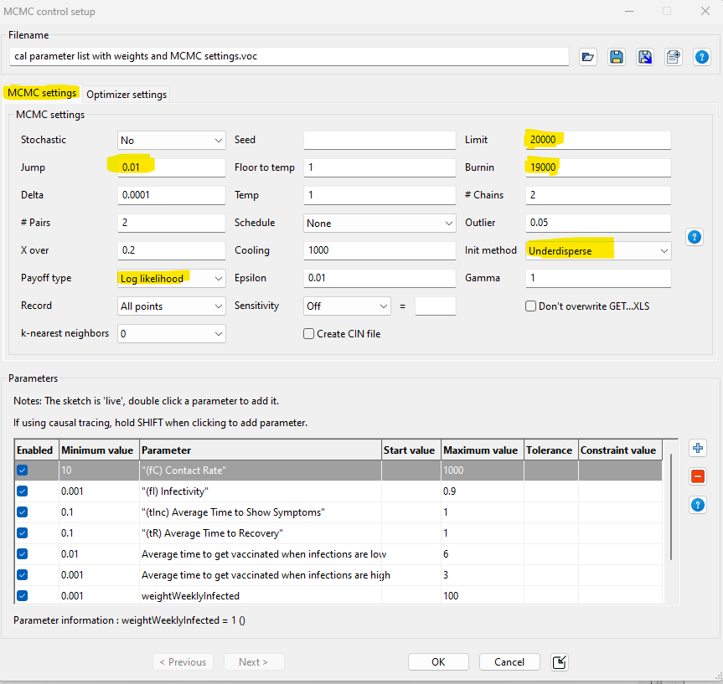
Update the optimization control file
In “Simulation Control” under “Optimize”
set up file `cal parameter list with weights
and MCMC settings.voc` with the
following settings (first switch “Optimizer
settings” to MCMC instead of Powell):

Slide 69
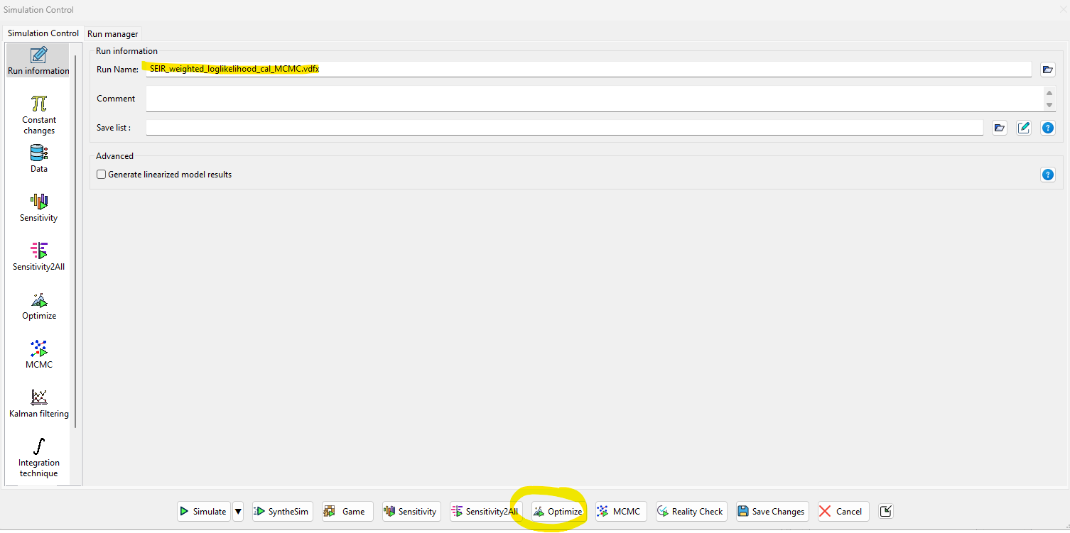
MCMC in Vensim ®
Let’s Calibrate!
Save the run name as “SEIR_weighted_loglikelihood_cal_MCMC.vdfx”
Hit “Optimize”

Slide 70
MCMC results
Explore the following files
SEIR_weighted_loglikelihood_cal_MCMC.vdfx (Vensim® run)
SEIR_weighted_loglikelihood_cal_MCMC.out (best parameter values found)
SEIR_weighted_loglikelihood_cal_MCMC_MCMC_stats.dat (best payoff and convergence diagnostics on random walk process)
SEIR_weighted_loglikelihood_cal_MCMC_MCMC_sample.tab (all points sampled after MCMC burn-in period)
SEIR_weighted_loglikelihood_cal_MCMC_MCMC_points.tab (all points explored during MCMC run)

Slide 71
Sensitivity Analysis Using MCMC Runs

Slide 72

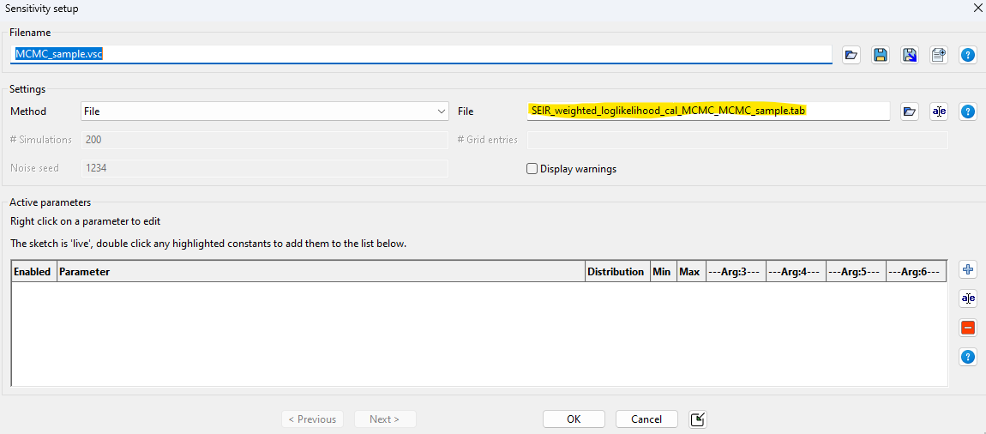
Set up sensitivity analysis using sample of 1000 MCMC runs
In “Simulation Control” under “Sensitivity”
set up file `MCMC_sample.vsc` by pointing to the file
`SEIR_weighted_loglikelihood_cal_MCMC_MCMC_sample.tab`

Slide 73
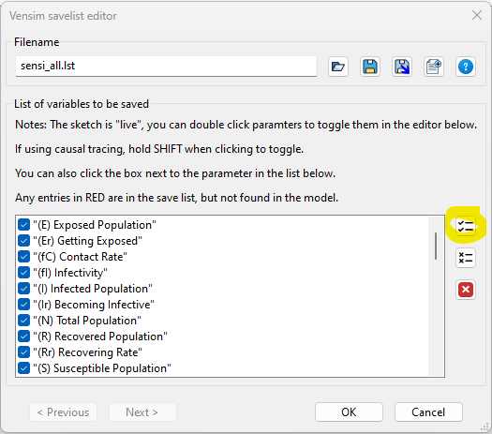
Select which parameters to include in sensitivity analysis
In “Simulation Control” under “Sensitivity”
set up file `sensi_all.lst` by selecting “All Variables”

Slide 74
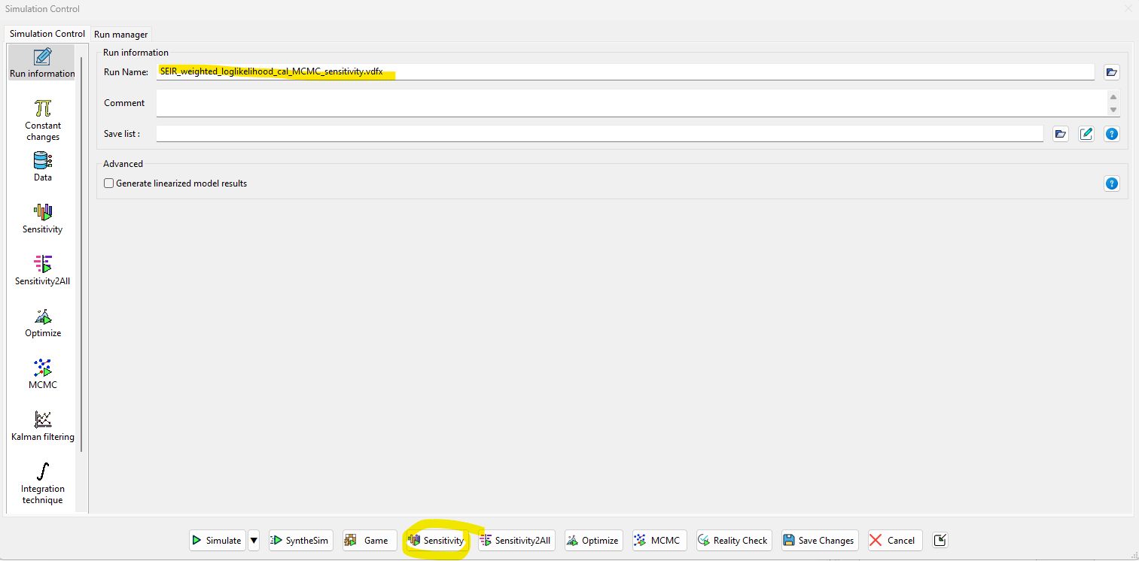
Sensitivity analysis
Let’s Simulate!
Save the run name as “SEIR_weighted_loglikelihood_cal_MCMC_sensitivity.vdfx”
Hit “Sensitivity”

Slide 75

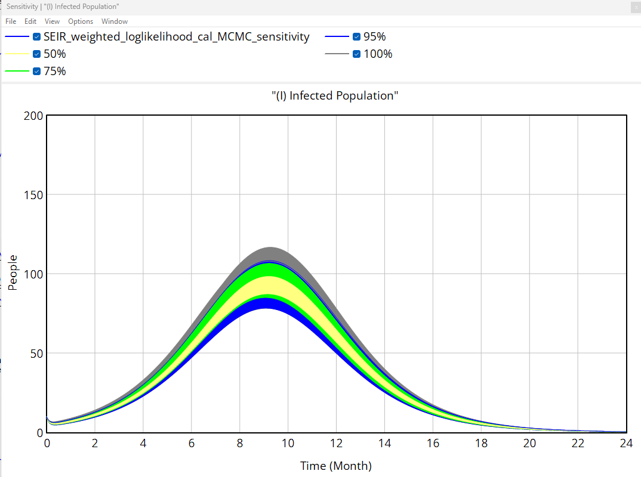
Sensitivity analysis
Let’s Simulate!
Confirm “SEIR_weighted_loglikelihood_cal_MCMC_sensitivity.vdfx” is loaded
Select any variable, and hit “Sensitivity Runs”

Slide 76
Wrap-Up

Slide 77
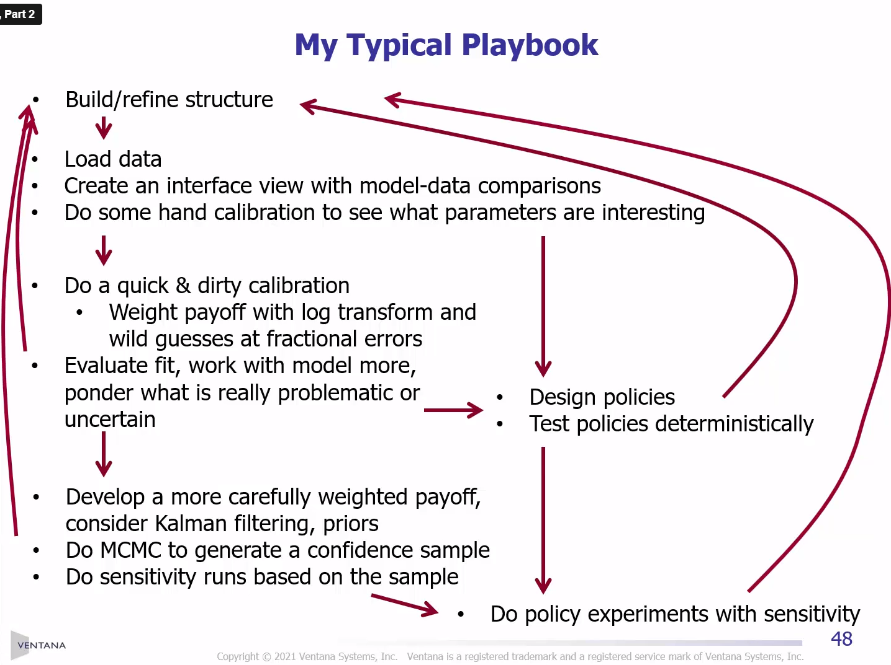
Tom Fiddaman’s

Slide 78
Additional Resources
https://vensim.com/vensim-video-library/
Andrade, J., & Duggan, J. (2021). A Bayesian approach to calibrate system dynamics models using Hamiltonian Monte Carlo. System Dynamics Review, 37(4), 283–309. https://doi.org/10.1002/sdr.1693
Barlas, Y. (1989). Multiple tests for validation of system dynamics type of simulation models. European Journal of Operational Research, 42(1), 59–87. https://doi.org/10.1016/0377-2217(89)90059-3
Barlas, Y. (1996). Formal aspects of model validity and validation in system dynamics. System Dynamics Review, 12(3), 183–210. https://doi.org/10.1002/(SICI)1099-1727(199623)12:3<183::AID-SDR103>3.0.CO;2-4
Dogan, G. (2007). Bootstrapping for confidence interval estimation and hypothesis testing for parameters of system dynamics models. System Dynamics Review, 23(4), 415–436. https://doi.org/10.1002/sdr.362
Oliva, R. (2003). Model calibration as a testing strategy for system dynamics models. European Journal of Operational Research, 151(3), 552–568. https://doi.org/10.1016/S0377-2217(02)00622-7
Rahmandad, H., Oliva, R., & Osgood, N. D. (2015). Analytical Methods for Dynamic Modelers. MIT Press.

